Slide 1


By: Kamila Lerner, Oludare Ishola, Moshood, Sunday,
Zhechun(James), and Wei

Slide 2
“Requirements Determination and Specification”
Group Project Deliverable # 2

Slide 3

Table Of Contents
Overview Statement
Users
Goals of the IS
Requirements Identification
Activity Diagram
Events
Use Case Specifications
Use Case Diagrams
Conceptual Model

Slide 4
Overview Statement - Purpose of the Project
This project overview is for the business transformation of the licenses and Regulatory Services - one of the four diverse business lines for Municipal Licensing & Standards (ML&S).
For the Licensing and Regulatory Services Unit, there are variances in the requirements for approval of business licenses and permits issued by the units. The applications are received primarily through paper-based processes. The time required to review and approve applications is high. It ranges up to several weeks and usually involves several visits by the client to the ML&S office location.

Slide 5
Overview Statement - Purpose of the Project...
This puts an unnecessary burden on businesses and individuals because decisions are delivered through outdated and inefficient business processes.
Standardized project methodologies will be followed for the design of business processes that are supported by simplified business rules, revised bylaws, and development of business requirements for the Online Business License Application. This would bring more control for long term sustainability.
The diagram below illustrate the ML&S modernization journey from the current to the transformation state:

Slide 6
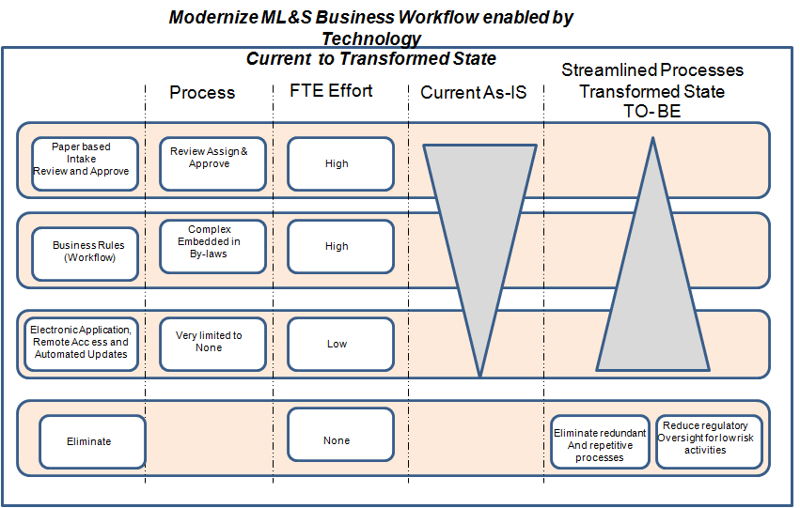
ML&S modernization journey from current to the transform state

Slide 7
2. Customers / users Of the System
Clients: User that interacts with the Licensing Application System through Extranet interfaces to obtain a license for business
Issuing Clerks: The clerks perform both frontend and backend functions; review, assess, assign, approve or deny application.

Slide 8
Customers / users Of the System...
Manager: The manager will issue the license number and make the final decision.
Zoning Inspector: The inspectors carries out the inspections and validates the zoning requests made by the issuing clerk on behalf of the client or zoning requests by the client.

Slide 9
3. Goal of the Information System
Anticipated Outcome(Goal) | Specific Objective/ Deliverables | Project Benefit
Online Business License Application | Facilitate Online-Self Service business license application 24/7 with ease. Provide new functionality and allow clients to apply for a license without business intervention | Increase the revenue by 10%, Customer satisfaction increases by 5%. Promote efficiency Eliminate manual task and redundancy Automates Business Processes
Streamline Business Processes | Streamline business supported by bylaws changes Processes documented and re-designed. New processes are implemented based on online application and socialized with staff and customers. | Streamline zoning/rezoning request to and from Toronto Building. These would decrease the time for issuing business licenses from current 6 weeks to 3 days. Combine task- Reduce number of hands off

Slide 10
Reduce Customer Wait Time at Counter | Shorten retrieval times for customer documents Provide self-service options to reduce need to come to licensing Office. | Access to digitized image copy of the file record will shorten customer’s time spent at the counter by 2%. Reduce almost 900 annual visits by customers to the Licensing Office for license application or other related issues by 50% after three month of implementation. Increased efficiency, communication, information flow.
Centralized Data Management System | Accessibility of information system Promotes flexibility | Accuracy and consistency in data storage

Slide 11
Overall goal is to:
To develop an online information system that allows business owners to:
Register online for a business license
Maintain efficiency by doing it online
Reduce their time of business approval
Maintain low costs
Have a legal and registered business
Have an interactive experience with the online system
Provide clients a service that is more convenient, accessible, legal, flexible and cheaper
System will save a consumer time and energy
Provide a benefit to the government because there will be more control and revision of the registered business before approval into the society
Provide customer satisfaction

Slide 12
4. Requirements identification and classification
Functional requirement
Non-functional requirement
Data Requirement
Requirement Elicitation Techniques
Requirements Document

Slide 13
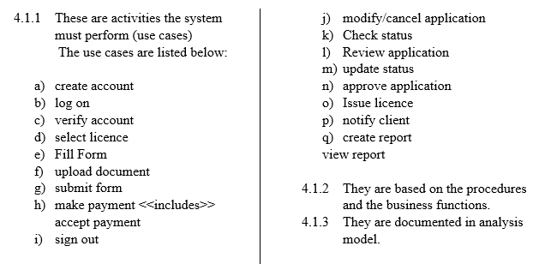
4.1) Functional Requirement – This describes a system service or functions

Slide 14
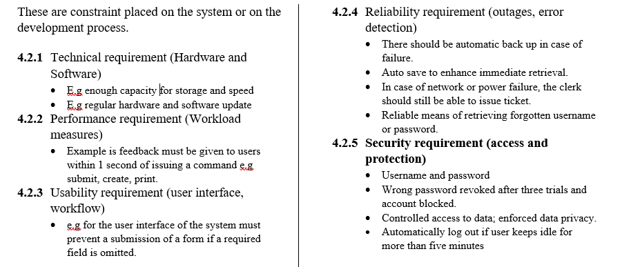
4.2) Non-Functional Requirements:

Slide 15
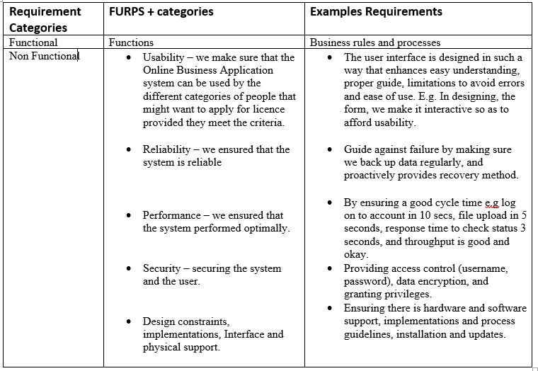
4.2.6 Tabular Presentation of Functional and Non-Functional Requirement and Examples

Slide 16
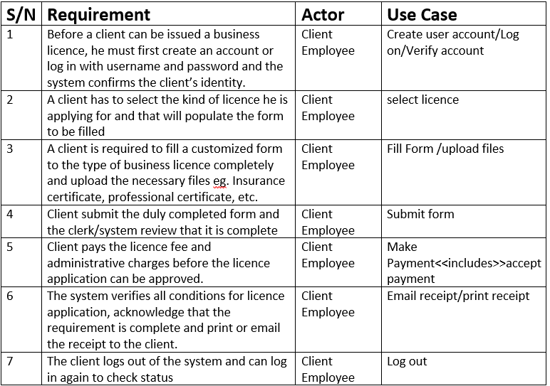
4.2.7 Assignment of Requirements to Use Case

Slide 17
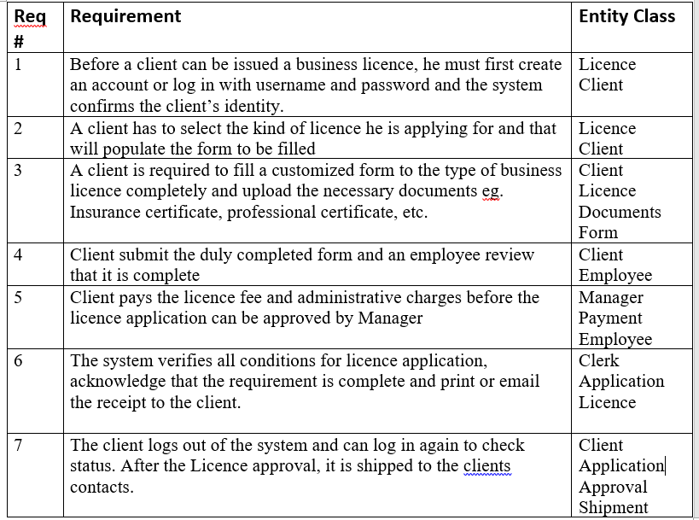
4.2.8 Assignment of Requirements to Entity Class.

Slide 18
4.3) Data Requirement
4.3.1 Determining data requirements
Each class has different attributes and data types. The database will contain tables for each Class with columns for the name, street address, city, state, postal code, and phone number, date, cost etc.
.
S/N | Class | Attribute
1 | Application | appName:String, appID:int, appDate:date, appCost:double appStatus:char
2 | Client | clientName:String, clientID:int, clientAddress:String
3 | Licence | licenceID:int, issueDate:date, expDate:date,
4 | Shipment | shmtID:Int, shmtAddress:String, shmtCost:double
5 | Payment | paymentID:int, paymentType: Char, paymentAmount:double.

Slide 19
4.3.2 Planning the database
In planning the database, we make sure that each of your tables has a primary key column—a column that contains values unique to each row in the table so that it will be easy to use the unique identifier to retrieve information.
4.3.3 Creating the database - We create the database using a database system like:
IBM DB2
Oracle RDBMS
Microsoft SQL Server.
SAP Sybase ASE
MySQL
4.3.4 Political and Legal Requirement - We make sure the polical requirements such as government regulations of data privacy, and accessibility is observed.

Slide 20
4.4 Requirement Elicitation Techniques
Linda Macaulay in Requirements Engineering (Applied Computing) defines it as a systematic process of developing requirements through an iterative and co-operative process of analyzing the problem, documenting the resulting observations in a variety of representation formats, and checking the accuracy of the understanding gained.
Below are what we did in this project:
Elicitation Steps:
• Identified sources of information
• Gathered facts
• Communication

Slide 21
4.4.1 Traditional Methods
Study of documents and software Systems
We studied the licencing office reports, the charts, policy manuals, job descriptions and the documentation of the existing systems.
Interviewing users and domain experts – We conducted interviews among users and domain experts to obtain the requirements. It is the most used technique but we used it in conjunction with other methods to determine what the present system does and also what stakeholders need
Advantages
It enhances flexibility and timeliness.
It helps to target specific things.
It is easier to summarise the result later.
It makes deeper understanding of requirements possible as one can progressively ask questions.
It also gives the possibility to reach out to stakeholders in geographically dispersed location.

Slide 22
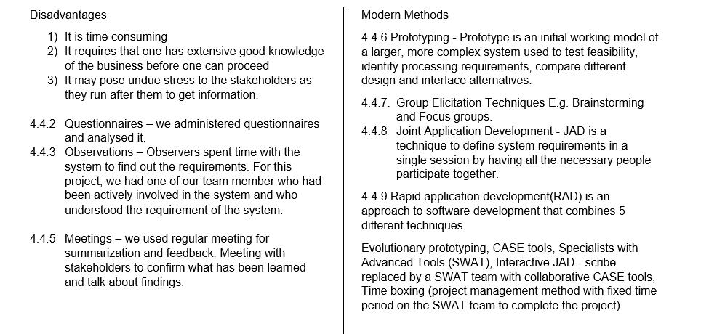
Traditional Method...

Slide 23
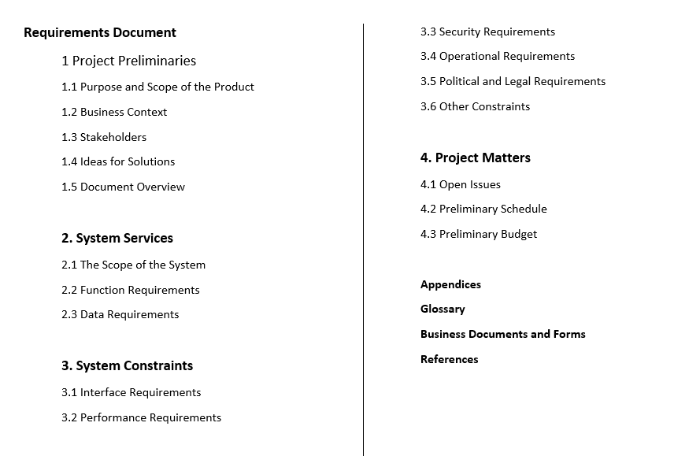
4.5 Requirements Document

Slide 24
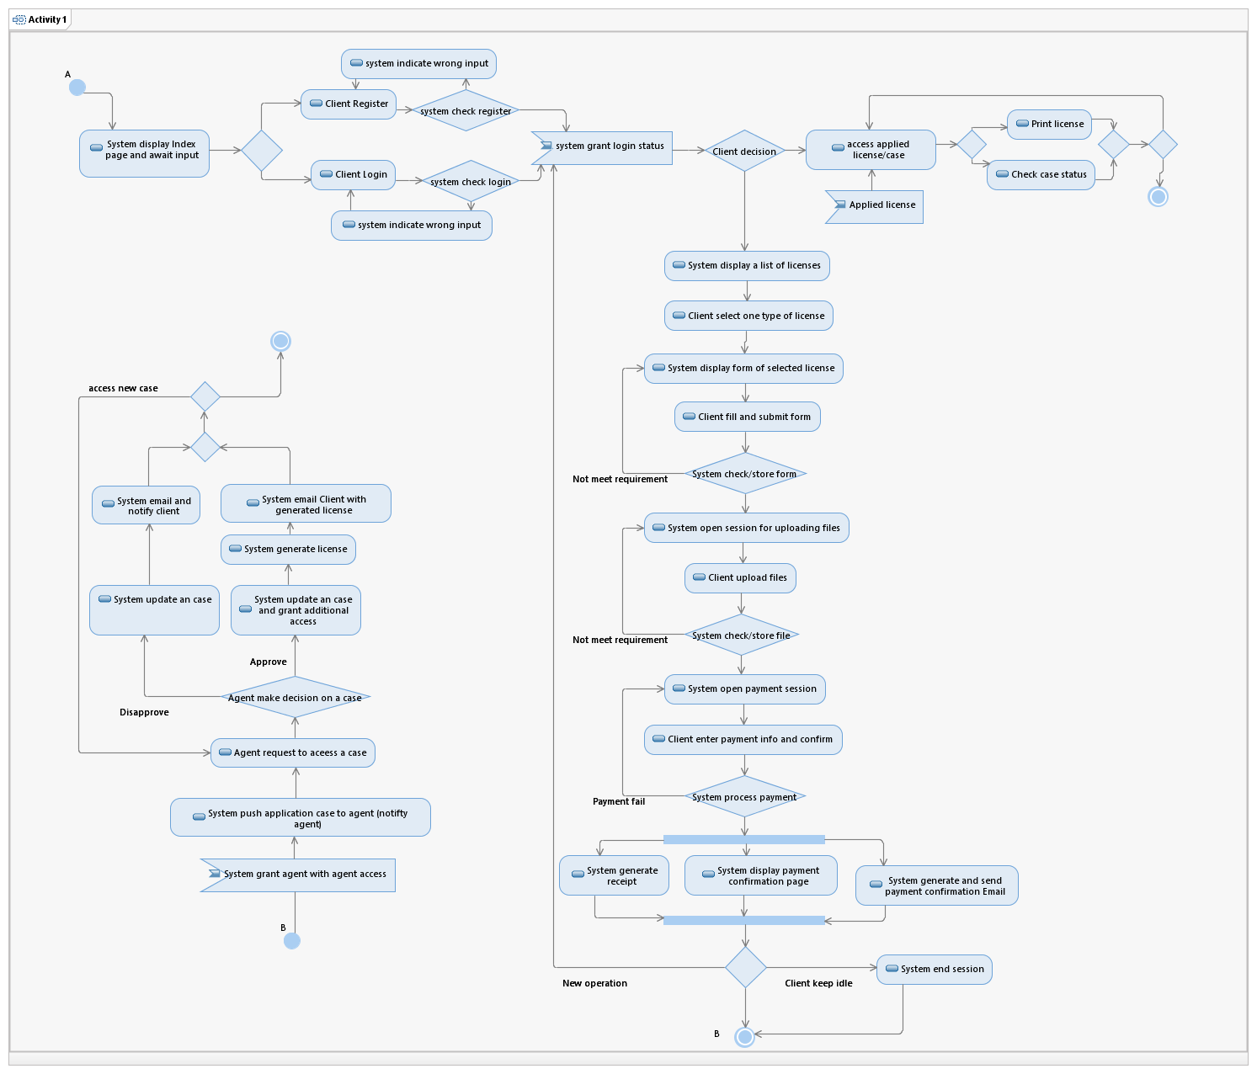
5. Activity Diagram

Slide 25
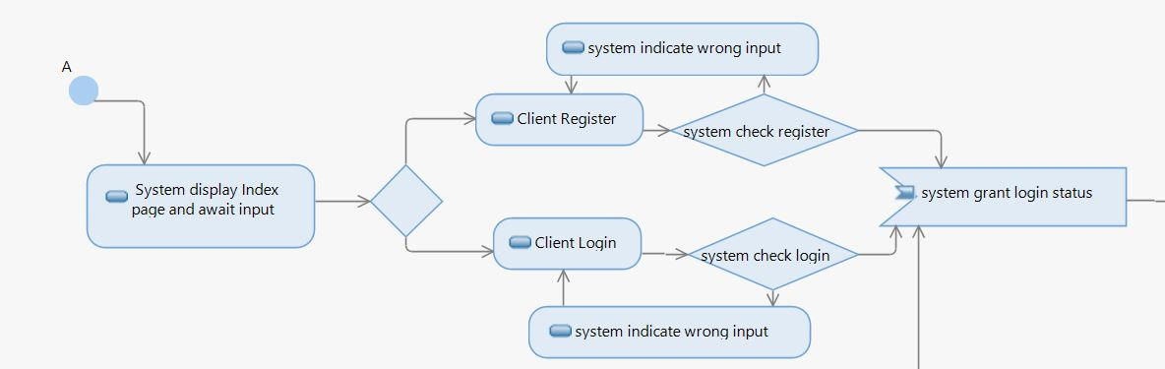
5.1 Register/Login

Slide 26
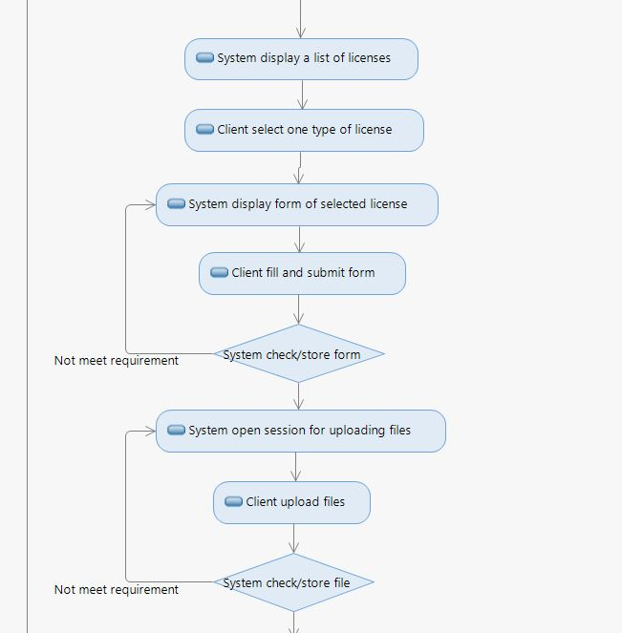
5.2 Filling Info

Slide 27
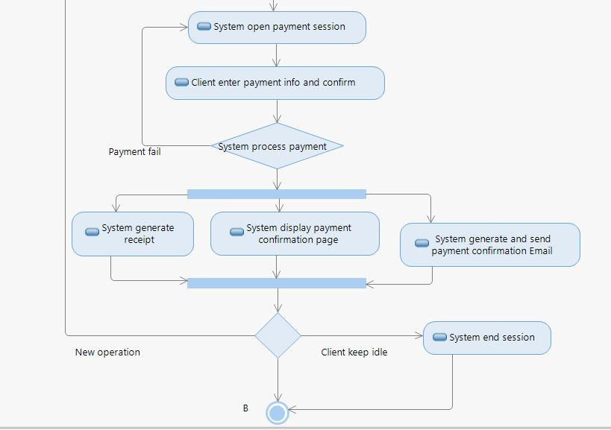
5.3 Payment

Slide 28
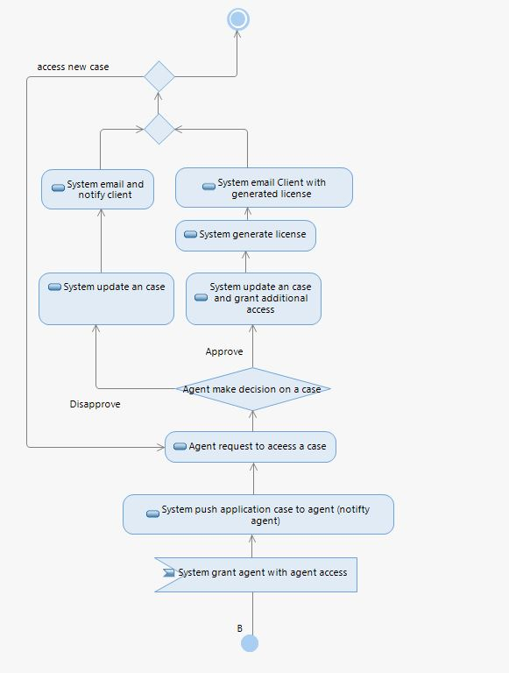
5. 4 Clerk-side Process

Slide 29
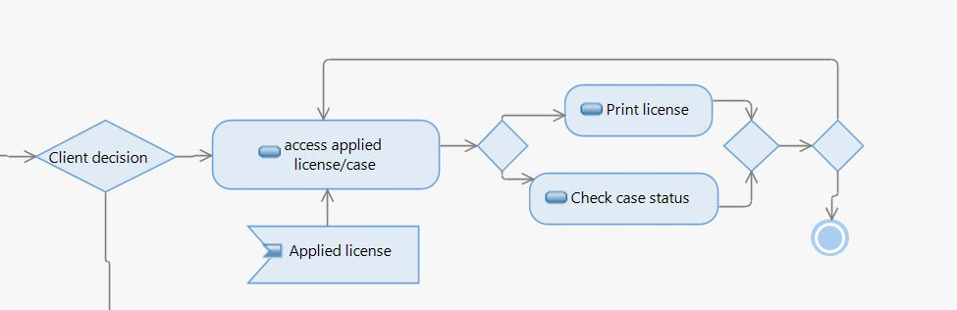
5.5 Client access applied case

Slide 30
6. Event Table
Event | Trigger | Source | Use Case /Activity | Response | Destination
Client creates an account | New account registration request | Client | create account | Notification of successful registration (or failure) | Client
Client logs in with account Info | Login request | Client | Verify and grant access | Grand access from this user and notification of successful Login | Client
Client selects particular licence | Item inquiry | Client | display licence lists | List of relevant items (types of application) | Client
Client completes BIS(business information sheet) form | Submission request | Client, (possibly other government Database) | check the form completeness | direct to the document upload page | Client
Client upload required documents | upload request | Customer, (possibly other government Database) | Check documents and store them at system database | document upload page or message of incompleteness of application submission Payment page or message of uploaded document disapproval or application number | Client , (possibly other government Database) 1

Slide 31
Event | Trigger | Source | Use Case /Activity | Response | Destination
Client gives payment info and confirm payment | Payment request | Client, Bank | Verify payment Info | 1.Notification of successful payment or failure 2.Transaction | Client, Bank, Credit bureau
client modify application detail (can be cancellation) | application modification request | Client | Verify and change application details (if possible) | Notification of successful change or failure | Client, (possibly other government Database), Bank (for cancellation)
Client wants to check application processing status | Application status inquiry | Client | Look up application status | Application status detail | Client
client wants to log out | logout request | client | terminate user’s session | Notification of successful logout | client
clerk reviews application | review request | clerk | present the documents been uploaded by clients | show documents | clerk
clerk updates status | status update request | clerk | update the application status | notification of application updated | clerk
zoning inspector checks the site (review application) | clerk finished the review | zoning inspector | present the status of the application and clerk’s approval | status of the application | zoning inspector

Slide 32
Event | Trigger | Source | Use Case /Activity | Response | Destination
System informs customer about the result of the application | Application approved or disapproved (status trigger) | system | System generate notification and Email notification | System notification and Email notification | Client, Email system
Client wants to print licences | Item(licence) request | Client | Verify request and retrieve licences | Page of licences in image form and downloadable document | Client
create report | end of the month | clerk | create monthly report | notification of monthly report generated | clerk
review report | report created | manager | look up monthly report | monthly report | manager

Slide 33
7. Use Case Specification
Use Case 1 : Create Account
Use Case 2 : Log In
Use Case 3: Fill Form (BIS)
Use Case 4: Make Payment
Use Case 5: Administrative Review
Use Case 6: Application Status

Slide 34
Use Case 1 : Create Account
Use Case Name: | Create Account
Scenarios: | Client search the system to apply for specific Business License Online
Triggering Event: | Client’s need to obtain License to do business in any part of City.
Brief Description: | The Create Account use case allows the User to create a login and become a Registered User on the ML&S System and able to apply for business license to operate businesses in Toronto.
Actors: | Client, Issuing Clerk, Manager, Zoning Inspector
Related Use Case(s): | None
Stakeholders: | Client, Manager
Preconditions: | Client must exist and residents of Ontario
Postconditions: | Success: The User entered data is stored in the user account. Confirmation is sent to the appropriate email address. The user account was not created: The User entered invalid data or chose to cancel the account creation request. In either case, no account will be created.

Slide 35
Basic Flow of Activities | This use case starts when the User accesses the system feature that enables him/her to create an account by entering information that is maintained in the User’s account.
Actor |  | System
1.0 The User enters the required User Account information values and requests that the system saves the entered values. 4.0 Use case Ends. |  | 2.1 The system validates the entered User Account information. 3.1 The values for the User Account information are stored in the User’s account. 3.2 The system notifies the User that the account has been created.
Exception conditions:
User Cancel request |  | At any time, the User may choose to cancel the account creation. At which point, the processing is discontinued, the user account remains unchanged, and the user is notified that the account management request has been cancelled.

Slide 36
User Enters Invalid User Account Information |  | If during Create Account, the system determines that the User entered invalid User Account information, the following occurs: 1. The system describes which entered data was invalid and presents the User with suggestions for entering valid data. 2. The system prompts the User to re-enter the invalid information. 3. The User re-enters the information and the system re-validates it. 4. If valid information is entered, the User Account Information is stored. 5. If invalid information is entered, the Entered Information is Invalid alternative flow is executed again. This continues until the User enters valid information, or chooses Cancel. Invalid User Account information: - Missing information items - Username already exists in the system - User Account information entered does not comply to its definition in the glossary - Not well formed email address - Offending words in any part of the User Account information

Slide 37
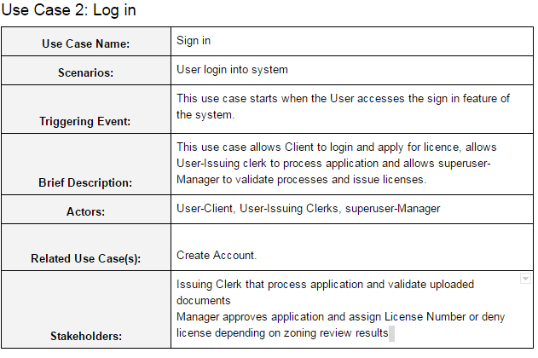

Slide 38
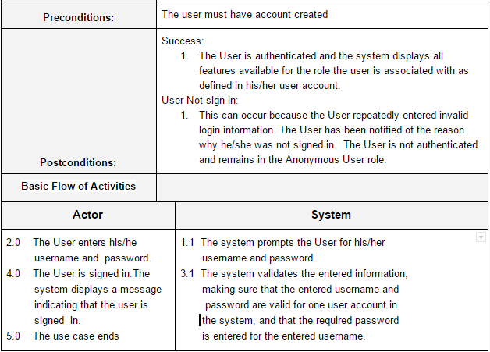

Slide 39
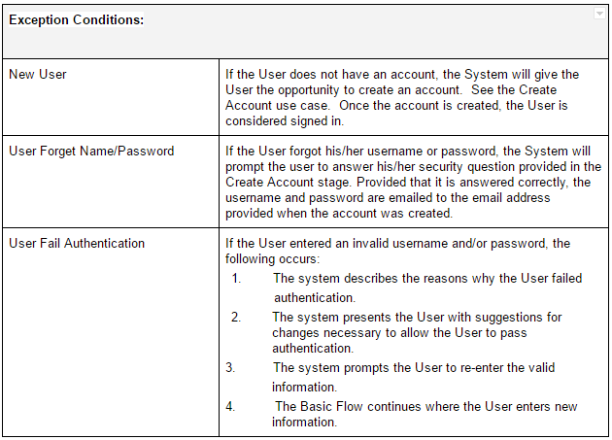

Slide 40
Use Case 3: Fill Form (BIS)
Use Case Name: | Fill Form (Fill BIS form)
Scenarios: | Client select business type and fill application form apply for specific Business License online
Triggering Event: | Client’s need to obtain License to do business in any part of City.
Brief Description: | The use case begins when the Client SELECT License type to complete form; Business Information Sheet.
Actors: | Client.
Related Use Case(s): | Create Account, login.
Stakeholders: | Manager, Issuing-Clerk.
Preconditions: | Client have user account Must have Criminal background check less than 280 days Must have two pieces of government proof of work status Must have Certificate of Insurance (if applicable) Medical Certificate (if applicable) Partnership agreement(if applicable) Agree to comply with provisions of ML&S bylaws, Code 545 and other laws that apply to permits.
Postconditions: | Success: The User entered data is stored in the user account. Confirmation is sent to the appropriate email address. 2. The user account was not created: The user account was not created, the User cannot complete application.

Slide 41
Basic Flow of Activities | The use case begins when user click on select business type
Actor |  | System
1.0 Client Click select business types button 2.0 Client selects business types 3.0 Enters information in the required field and agree to comply with provisions of ML&S bylaws, authenticated by enters his/her name in the signature column. 5.0 Client Uploaded the required documents 7.0 Client click submit button |  | 1.1 Displays the different business license types available [See list of business licenses] “Drop down list appear”. 2.1 Pop up Form (BIS form) to complete 4.1 Prompt client to upload individual documents 6.1 Prompt client to confirm submission 8.1 Successfully uploaded Use case Ends.
Exception Conditions:
User Cancel Application |  | At any time, the User may choose to cancel the Application. At which point, the processing is discontinued, the user account remains unchanged, and the user is notified that the account management request has been cancelled.

Slide 42
Use Case 4: Make Payment
Use Case Name: | Make Payment
Scenarios: | Client make payment.
Triggering Event: | Client’s need to make payment to complete application.
Brief Description: | The use case begins when the Client click payment session.
Actors: | Client.
Related Use Case(s): | Fill form.
Stakeholders: | Manager, Issuing-Clerk.
Preconditions: | Client have completed business Information sheet (BIS Form) Client have uploaded requirements and submit.
Postconditions: | Success: The User entered payment information confirmed successful is stored in the user account. 2. Confirmation is sent to the appropriate email address. The user payment information was not accepted: The user payment information was not complete, The user application is unsuccessful.
Basic Flow of Activities | The use case begins when user click on payment session
Actor |  | System

Slide 43
1.0 Client select payment session 2.0 Client enters names, Card numbers, select Card Type from drop down and enters CCV number as it appears on the payment Cards. Use case Ends. |  | 1.1 Prompt client to enter payment information. 1.1a “Enter names as it appear on Card” 1.1b “Enter Card Number” 1.1c “Enter Card Type[Drop down]” for card type list 1.1d “Enter CCV [Back of Card number] 1.1e “Enter Expiry month and year” 3.1 Confirm submission successfully
Exception Conditions:
Wrong account information Insufficient funds |  | If in step 1.1 of the basic flow the payment information submitted is associated with the existing account then system shall display the message “Invalid Account information”, please try again. If after three attempt, system cancel the transaction. If in step 2.0 of the basic flow the fund on the Client Card is not up to required licence and registration fees, the system shall display a warning message and ask the Client to use another Credit/debit Card. If after three attempt the system will cancel the transaction.

Slide 44
Use Case 5: Administrative Review
Use Case Name: | Review Application
Scenarios: | Application form and documentation review
Triggering Event: | Client’s need to obtain License to do business in any part of City.
Brief Description: | The use case begins when the Client complete application and upload documentation for License type.
Actors: | Issuing Clerk, Manager, Zoning Inspector.
Related Use Case(s): | Fill form, Make Payment .
Stakeholders: | Manager, Issuing-Clerk, Zoning Inspector
Preconditions: | Client have completed business Application form (BIS) Uploaded supporting documentation and paid processing and License fee. System has generated automated license Number as reference for the Client application.
Postconditions: | Permitted: Result form will be generated and notify Client sent through email as “Permitted”. Confirmation is sent to the appropriate email address. 2. Not Permitted: The the result will be generated and notify Client, sent through email as Not Permitted”
Basic Flow of Activities | The use case begins when user click on select business type

Slide 45
Actor |  | System
2.0 Based on the License number, Issuing Clerk perform licensing review of application documentation 4.0 Zoning Inspector perform zoning check 5.0 Results of zoning check is entered into the system by inspector. 6.0 Based on the zoning results, the Manager grant approval or deny. 7.0 Issuing clerk notify the Client accordingly. |  | 1.1 System generates License number for the client application 3.1 System nightly batch application for zoning review to Zoning Inspector Use case Ends.
Exception Conditions:
Insufficient Information on Zoning Permitted with Conditions: |  | Template will be sent to client via an automated email to make up documentation within specified period. Updated request form with details of the conditions and constraints will be sent via automated email to client and issuing Clerk.

Slide 46
Use Case 6: Application Status
Use Case Name: | View Report
Scenarios: | User are able to view application status
Triggering Event: | Client’s need to obtain License to do business in any part of City.
Brief Description: | The use case begins when the Users SELECT View Report
Actors: | Issuing Clerk, Manager.
Related Use Case(s): | Make Payment, Review Application.
Stakeholders: | Manager, Issuing-Clerk.
Preconditions: | Client have completed business Application form (BIS) Uploaded supporting documentation and paid processing and License fee. System has generated automated license Number as reference for the Client application. Zoning check and review in process or completed
Postconditions: | Success: The information would be displayed on the current page No entries: Client does not exist or transaction cancelled.
Basic Flow of Activities

Slide 47
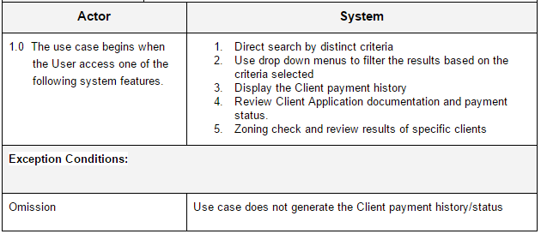

Slide 48
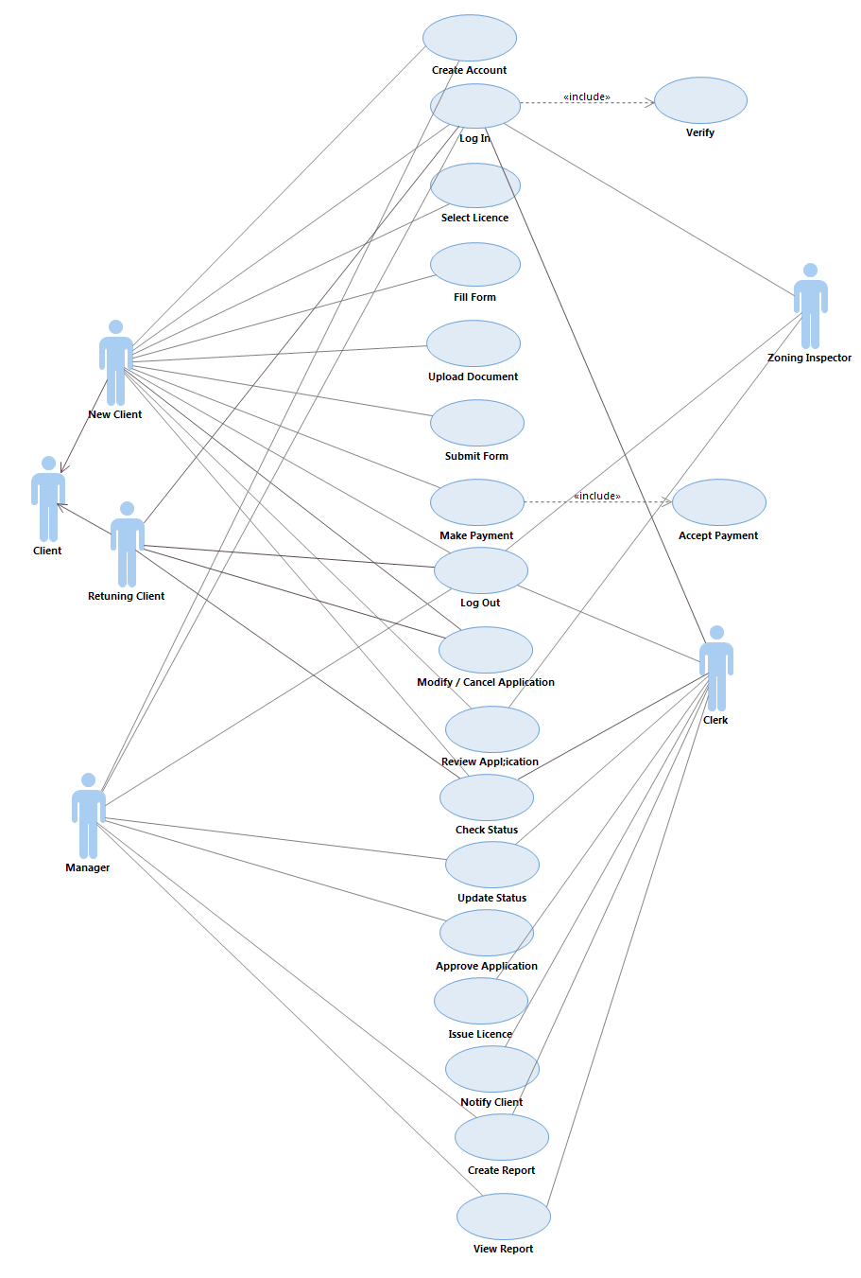
8. Use Case Diagrams

Slide 49
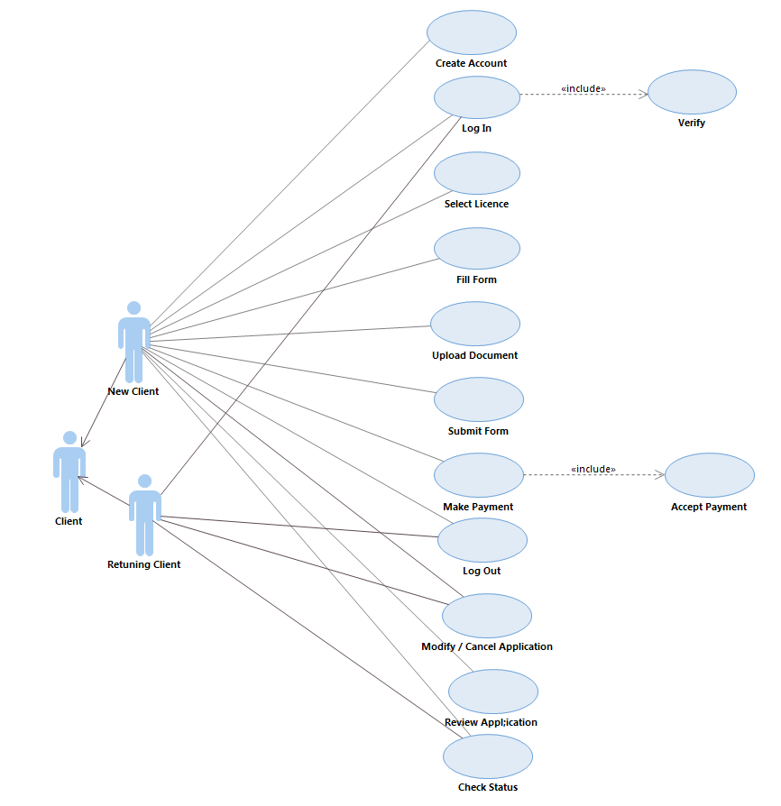
Client

Slide 50
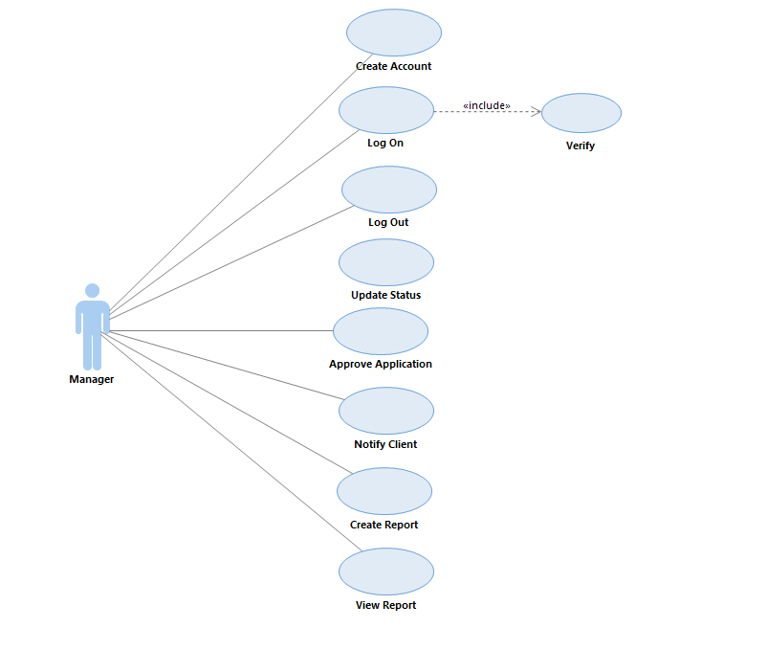
Manager

Slide 51
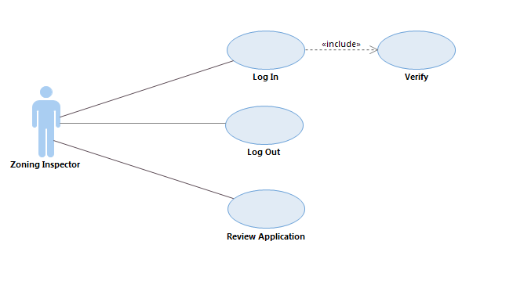
Zoning Inspector

Slide 52
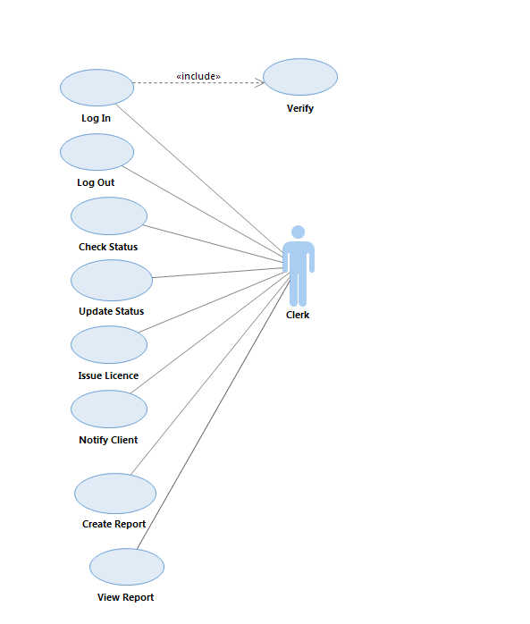
Clerk

Slide 53
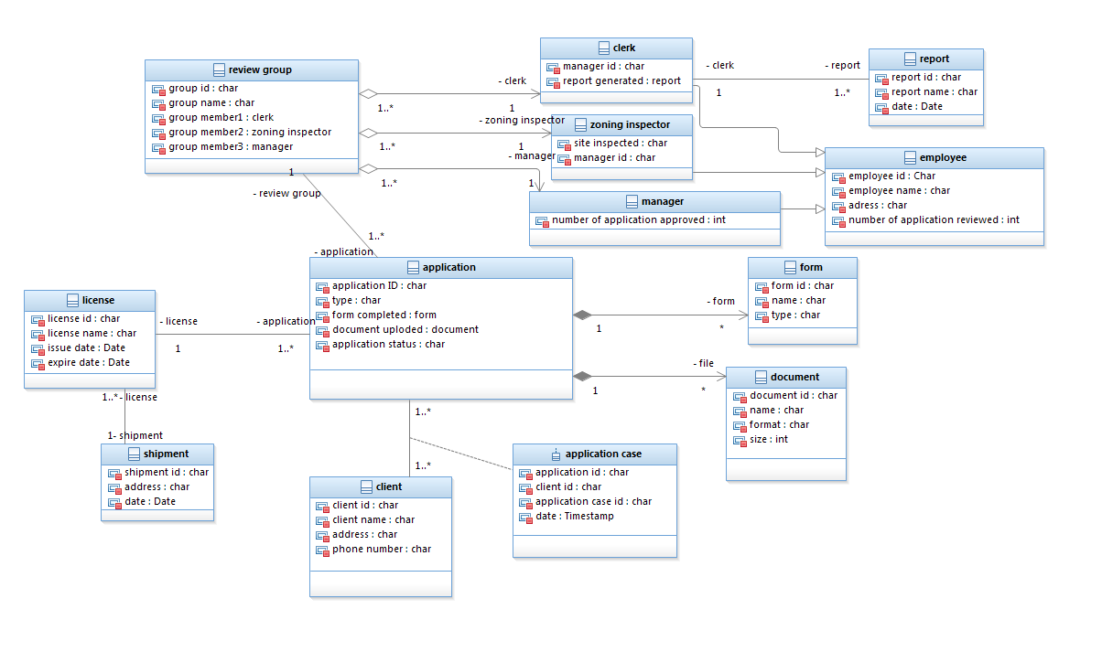
9. Conceptual Model

Slide 54
Roles and Responsibilities
Sections Actor
Overview Statement Kamila & Moshood
Users Kamila & Moshood
Goals of the IS Kamila & Moshood
Requirements Identification Sunday
Activity Diagram Wei
Events Wei & James
Use Case Specifications Moshood
Use Case Diagrams Dare
Conceptual Model James

Slide 55
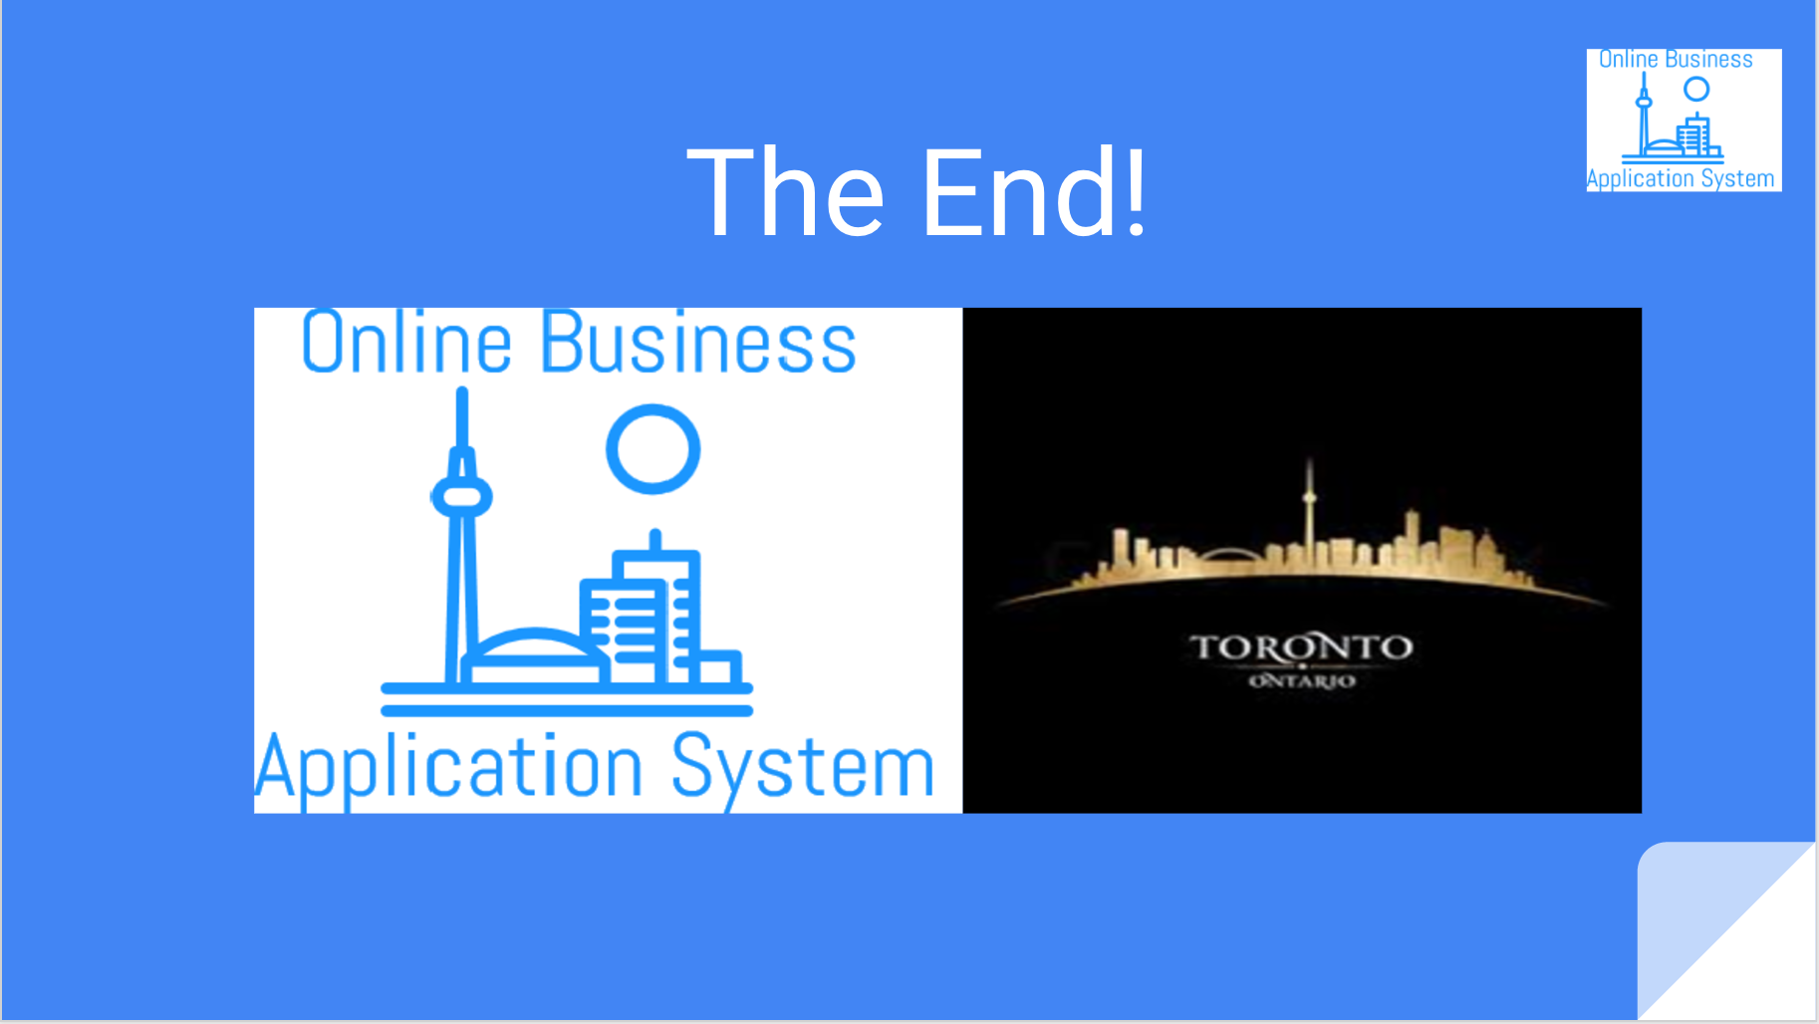
Thank you

